Slide 1
Blog Creation Project
Name: Jaismine Kaur

Slide 2
Q.1. Identification of Theme/Topic
(a). Please mention your blog URL
(b). Reasoning
(Please mention the reason behind selecting the theme/topic for your website in 30 words)
https://jaismine-kaur.dmlearning.in/
Being enthusiastic about literature, art, and cinema, I have chosen to write about the same, and hence named the page Lore Cinema. This describes what the expected content regarding the stories in and about Cinema should be on the blog.

Slide 3
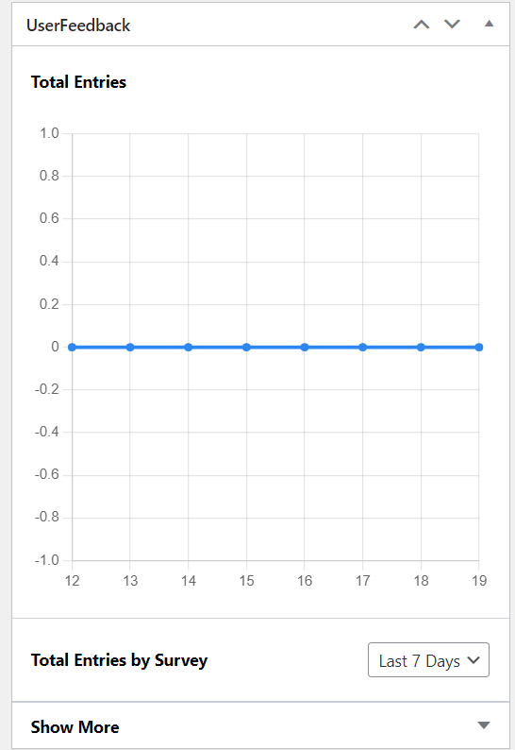
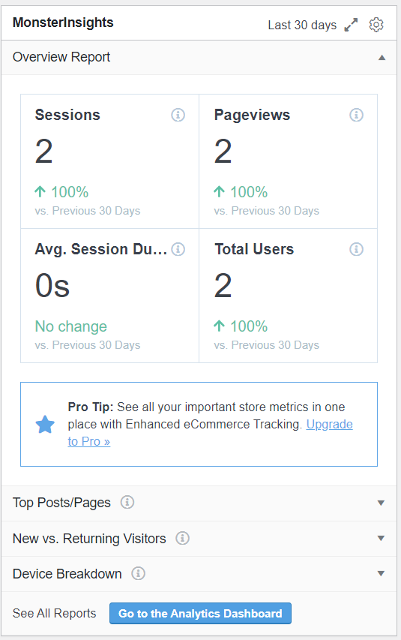
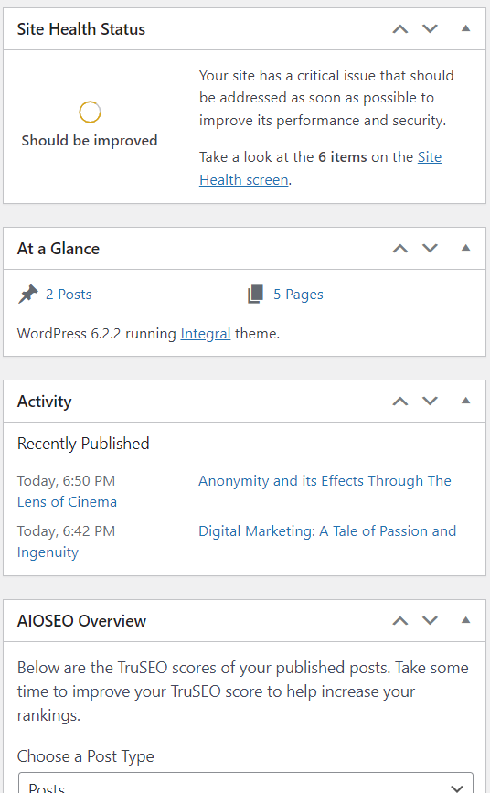
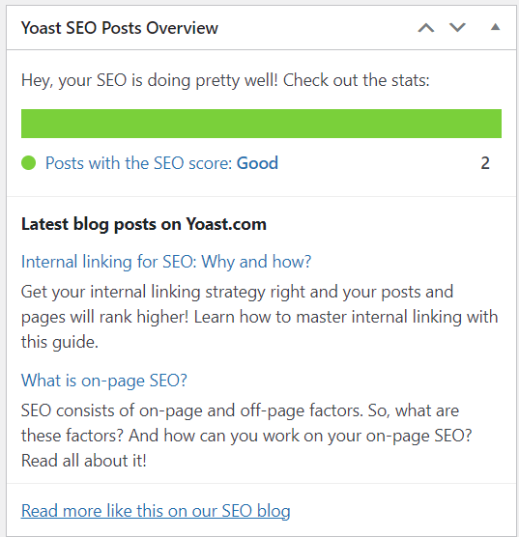
Q.2. WordPress Dashboard (Please provide the screenshot of your WordPress Dashboard)

Slide 4
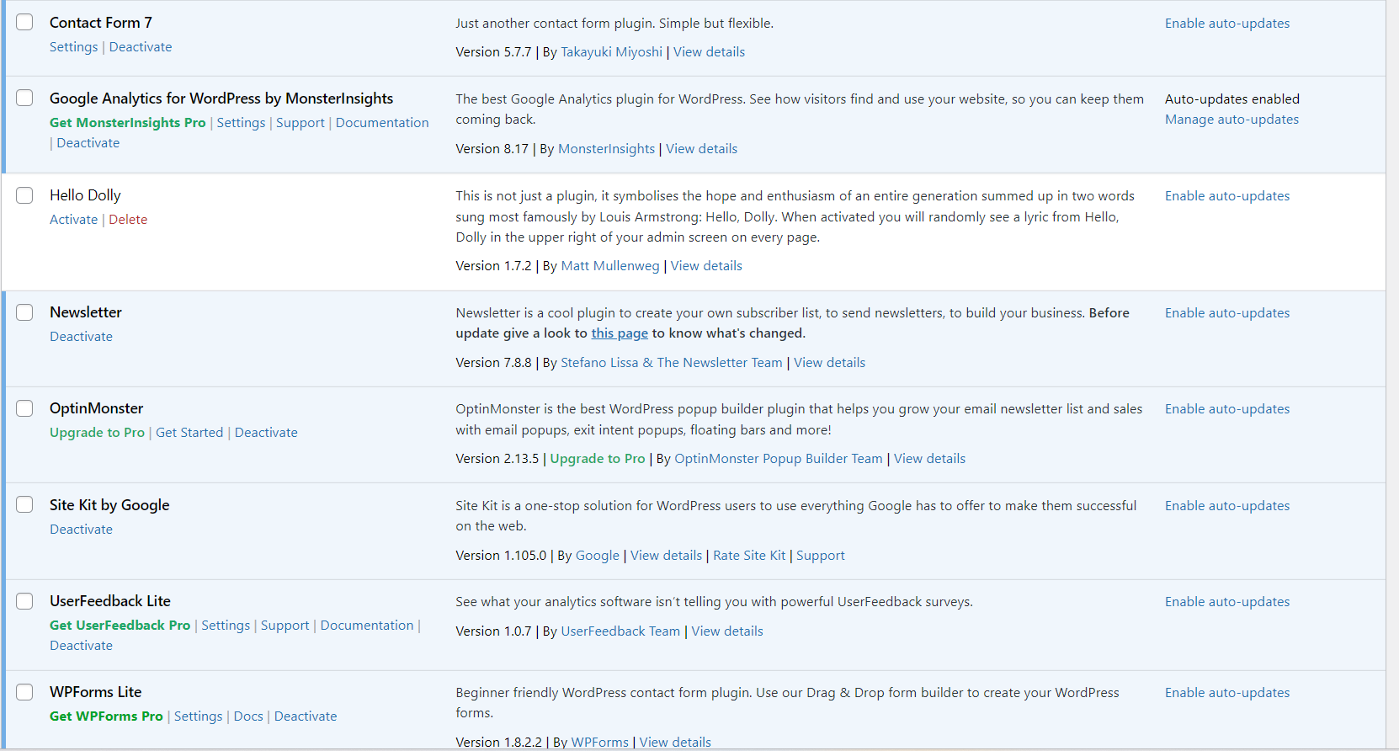
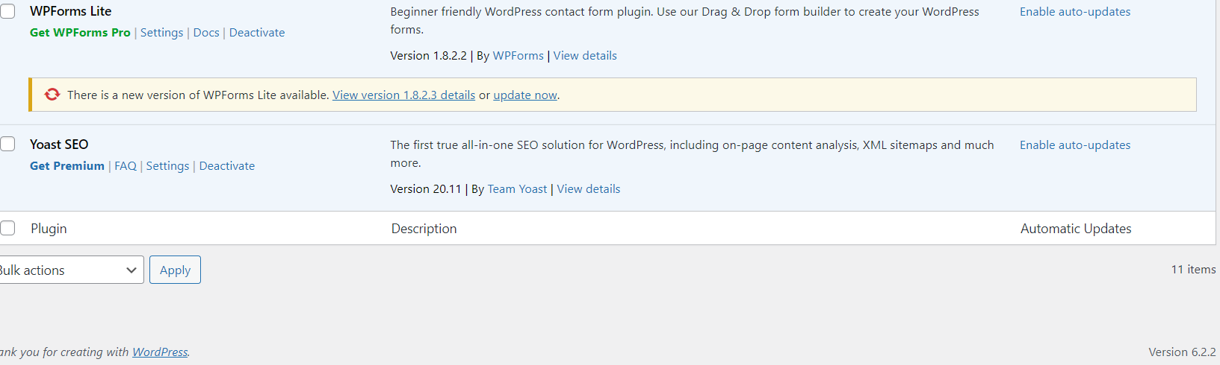
Q.3. Plugins Screenshot (Please provide the Screenshot form “Installed Plugins” Screen)

Slide 5
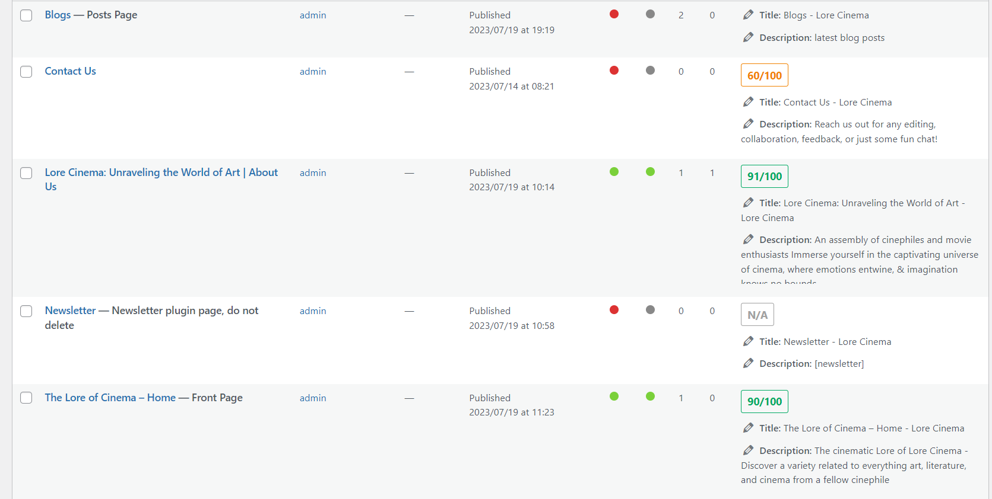
Q.4.a. Screenshot of ‘All Pages’ (Please provide the screenshot from ‘All Pages’ tab of WordPress)
Add Screenshot

Slide 6
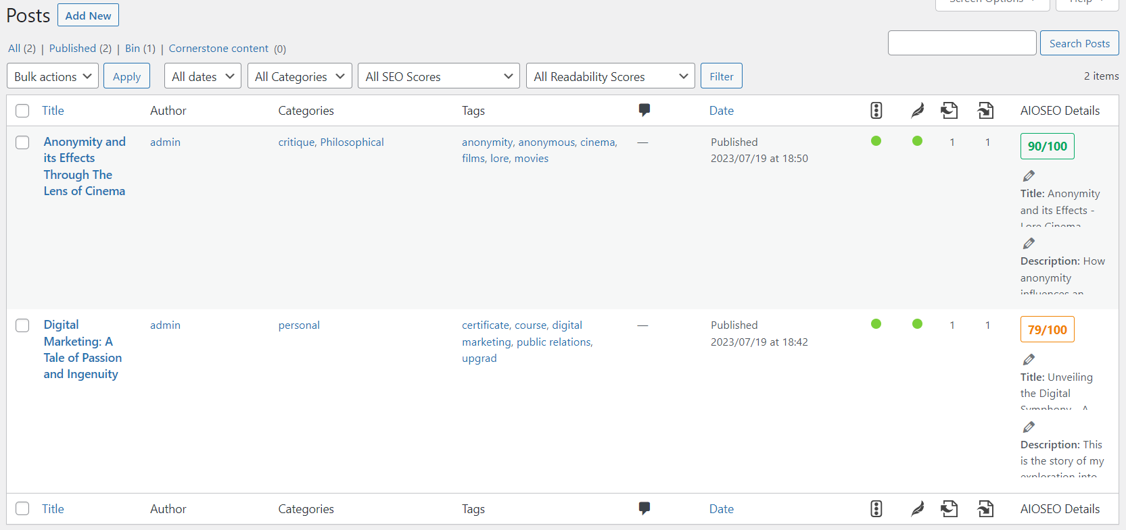
Q.4.b. Screenshot of ‘All Posts’ (Please provide the screenshot from ‘All Posts’ tab of WordPress)

Slide 7
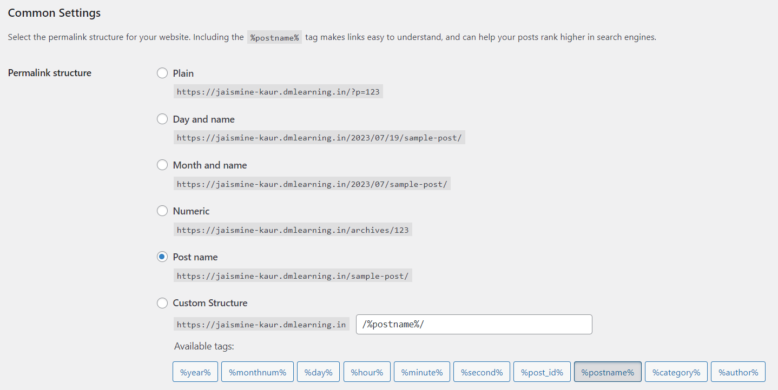
Q.5. Permalinks Screenshot (Please provide the Screenshot from Permalinks screen and justify the reasoning of selecting the respective Permalink)
Reasoning
The link when shared is easier to navigate.
Features:
Post name: allows user to locate which post they are viewing in the address bar.
Link Length: Is concise and communicates the information summary being viewed

